Slide 1

Democracy Enigma: An Analysis of Constitutional Amendments in Pakistan
Welcome To My Presentation
On
By:
Bushra Jabeen
Department of Pakistan Studies
Kinnaird College for Women, Lahore

Slide 2
Learning Outcomes
Introduction
What is constitution?
The Constitution as Legal Social and Political Document
Elite Accommodation and Fundamentalist
Jinnah’s Speech
The Objective Resolution
Muhammad Ali Bogra Formula
The First Constitution of Pakistan
1962 Constitution of Ayub Khan (1956)
What is parliamentary system?
1962 constitution
The Basic Democracy system in Constitution of (1962)
Constitution of 1973
Main Characteristics Of 1973 Constitution
Amendments in 1973 Constitution

Slide 3
Abstract
Pakistan inherited a British bureaucratic dominated democracy with lack of participatory system, identified as bureaucratic authoritarianism, military manipulation, religious political elite groups, industrial merchant class and landed aristocracy.
The present study explores different amendments in the constitutions came after several decades of military and autocratic rules which had dismembered Pakistan’s constitution to serve the Interest of the ruling classes and centralized fiscal powers at the federal level .
These political and non-political forces invariably bring change in the existing political structure of the country to safeguard their benefits into the constitutional framework. It finds and concludes that the successive rulers whether dictators or democrats incorporated amendments to serve their personal interest. Successive regimes has transformed the country from a state to an estate.

Slide 4
Introduction
In democratic states constitution meant to be a body of fundamental principles. The government governs. A constitution governs the government. Government brings order in the society. Constitution brings order in the government. Constitution being a mega law it serves as the higher principal and higher moral power. The constitution provides the a broader set of principals, political values, ideals and the goals of the country.

Slide 5
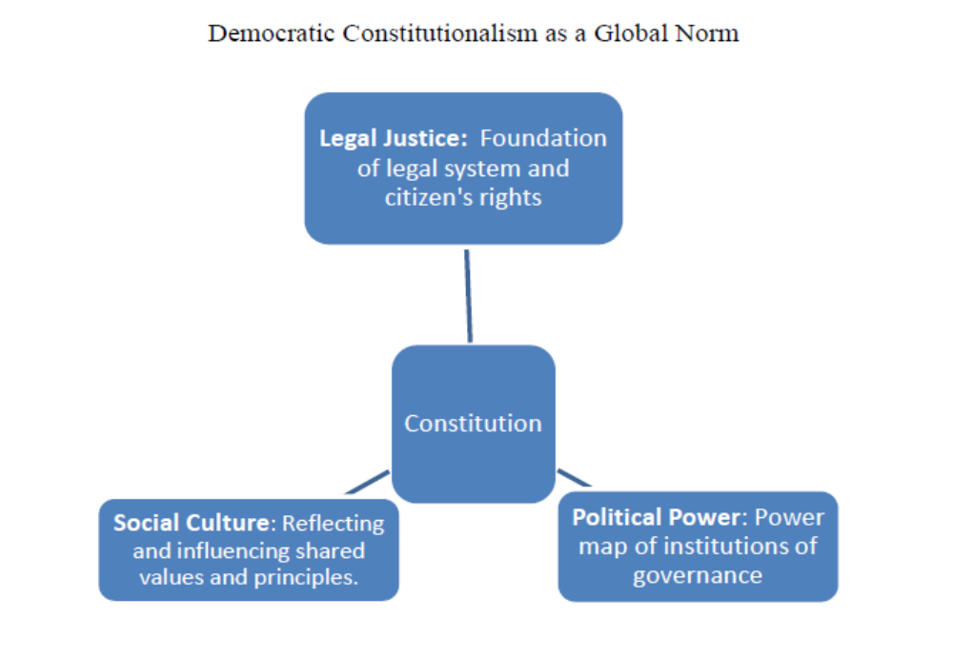
The Constitution as Legal Social and Political Document

Slide 6
Cont.…
According to IDAF( International Institute of Democracy and Electoral Assistance)
A constitution is a set of fundamental legal-political rules that:
Are binding on everyone in the state,
Concern the structure and operations of the institutions of government, political principles and the rights of citizens;
Are based on the widespread public legitimacy;
Are harder to change than ordinary laws (e.g. a two-third majority or a referendum is needed;
As a minimum, meet the internationally recognized criteria for a democratic system in term of representation and human rights.

Slide 7
Elite Accommodation and Fundamentalist
Establishing a democratic constitution was not an easy task in Pakistan.
There were various distinguished groups (landlord oligarchy, military and bureaucracy) representing of wealth and power and religious elite sects are being identified as main hurdles were in making a new constitution of Pakistan.
The Bengali majority in population and Islamic fundamentalist’s demanding share in political power structure .
The majority people of Pakistan congruently wanted constitution and the political system for Pakistan related with Islamic principles of life. The orthodox religious classes want to establish a moralistic and sententious Islamic state with emphasis on disciplinary, corrective and stringent role of Islam.
The other group emphasize on doctrine of the equality of all people and the protection of political, socio-economic rights, justice and desirability in civil and political rights.

Slide 8
Jinnah’s Speech
A conflict was raised on Jinnah’s statements for constitution making proses.
In one speech he emphasized to promote democracy according to the Islamic principles was adopted by orthodox religious parties as political agenda.
In second speech ,his presidential address to the constitutional assembly on Aug 11 1947 he said:
"You may belongs to any religion, creed and cast that has nothing to do with business of state….we are starting in the days where there is no discrimination no distinction between the communities……we are all citizen and equal citizen of state…"

Slide 9
The Objective Resolution
The Ahrar and JI joined hands in 1949 and began pressuring Liakat Ali Khan,s government to ensure an Islamic government in Pakistan the orthodox Muslim group was succeeded to extent the government to passes a Objective Resolution.
The Objective Resolution 7 march 1949 was a framework to provide guidelines to constitution makers to form an Islamic society in Pakistan.
Making an Islamic constitution was contrary, as Muslim society divided on sectarian blocks. If the Islamic fundamentalists was looking for an Islamic constitution was strenuous required that which sect should be declare a supreme law of the state, whether constitution should be based on Sunni Law or on Shia Law or on Wahhabi Law.

Slide 10
Muhammad Ali Bogra Formula
Muhammad Ali Bogra presented a constitutional formula in front of first constituent assembly in 1954.
The plan proposed for bicameralism legislature with equal representation for all five provinces of country in upper house. A total 53 seats were reserved for the upper house.
The Constitution assembly empowered the governor general to integrate West Pakistan into One Unit.
So the both wings have 175 seats each the two houses of legislature.
Both houses were given equal powers and in the case of the conflict between the two houses the issue was to be presented in fort of a join session..
Through Bogra Formula of One Unit and equal representation of both wings we denied to accept Bengali majority in parliament

Slide 11
The First Constitution of Pakistan (1956)
Early 1955 was the hard work of Ch Muhhamad Ali resulted into 1956 constitution which did not enjoy the absolute support of political parties.
The 1956 constitution introduced a strong tradition of violation of parliamentary norms.

Slide 12
What is parliamentary system?
In parliamentary form of government the real executive authority powers are vested into cabinet consisting of Prime Minister and important minsters responsible to the legislature.
In countries having parliamentary system, it is necessary to have a separate head of state (not of government) who normally exercise only ceremonial and formal functions. Besides, a neutral constitutional official is needed to full the gap between the one government and the others. He does not take over the government but provides decisions necessary for the bringing new government in place.
The parliamentary constitution limited the discretionary powers of president to appointments of members and heads of public service commission and election commission but a discretionary power of far reaching consequences was to appoint from among the members of National Assembly a Prime minister who in his opinion was most likely to command the confidence of majority of members of National Assembly.

Slide 13
Cont..
In 1956 constitution All key powers vested to designation of president like
To veto the amendments of constitution, to proclaim emergency, could assume provincial powers or can direct governor to assume all powers.
prime minister shall hold his office during president pleasure made president designation as a dictator having edge on all parliamentary political forces.

Slide 14
1962 Constitution of Ayub Khan
Ayub khan imposed martial law in 1958 and abrogated 1956 constitution.
Ayub khan,s military regime did not promote the development of political institutions, fostering instead its hegemony in the political, social and economic spheres.
He introduced a new constitution 1962 to perpetuate his role in the country.
The constitution was apparently parliamentary form of government and was presidential in practice with especial authorities. Actually it was a one man show
The president Ayub khan was empowered with special authorities moved to consolidate his hold over the political system.
A new system of local bodies called the basic democracy (BD) system was introduced by an order on 27 October, 1959.
President was to be elected independently of the Legislature and had a direct mandate from the elections to perform the executive functions.
His election was to be through the Electoral College consisting of 80,000 members of the local bodies, called BD members.

Slide 15
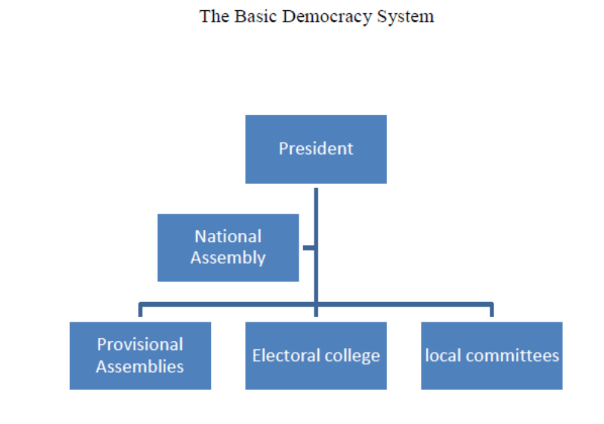
The Basic Democracy system in Constitution of (1962)

Slide 16
Powers of President (1962 constitution)
The president was to be elected for a fixed period of 5 years and could not be removed from his office by an adverse vote of Legislature.
President was the central point of all the Executive, legislative, and Judicial powers.
Cabinet was responsible to him.
All key appointments were to be made by him.
He can issue ordinances and can promulgate state of emergency in the country.
He can veto and rectified the legislature laws.
He could be removed only by a special process of impeachment, as provided in the constitution.
The 1962 constitution described as that of the Ghanta Ghar clock tower of Lyallpur (now Faisalabad) where all the seven bazaars converged.

Slide 17
Constitution of 1973
Ayub resigned in 1969 and Gen Yahiya khan imposed second martial law in Pakistan
In 1971 East Pakistan was separated.
Bhutto was installed in the office by army and appointed civilian chief martial law administrator.
With his efforts a new constitution was inducted the country.

Slide 18
Main Characteristics Of 1973 Constitution
The parliamentary system
The parliamentary system has been adopted.
All Executive authority shall be exercised in the name of President by the federal government consisting of Prime Minister and the Federal Ministers.
The Prime Minister shall be the Chief Executive of the federation of Pakistan.

Slide 19
Election of Prime Minister
The Prime Minister (PM) shall be elected by the majority of total members of National Assembly.
The office of Prime Minister is made extremely powerful and the office of president is made correspondingly weak, ineffective and dependent.
Power of appointments: the president shall appoint chief of Army, navy air force and chairman joint chief of staff on the advice of prime minister.

Slide 20
Position of President in 1973 constitution
The President is a ceremonial and nominal head of the state without executive powers.
He could not veto any legislative bill as the bill would become law on the expiry of 7 days if the president does not assent it.
The Prime Minister’s advice is binding on President.
The national Assembly would stand dissolved on the advice of Prime Minister even if the President did not agree.

Slide 21
Federal System
The federal system has been adopted in the constitution with clear distribution of powers between the federal government and provincial government.
The legislature powers of the federal government are enumerated in federal list, which made Defense, Foreign Policy, Communications, Water And Power as being most important .
The 47 subjects a concurrent list meant for Centre and provinces.

Slide 22
Safeguards For Provincial Interests.
The Council of Common Interests(CCI) (industrial development, water, power and railways)
The National Economic Council(NEC) (financial, commercial, economic and social matters)
The national finance commission(NFC) (sharing of net, proceeds of certain federal taxes between the federation and provinces)
Prime Minister is Head and Chief Minister are members

Slide 23
Bicameral Legislature
Two Chambers Legislature:
The National Assembly (Population Base):
There are a total of 332 seats in the National Assembly. Of these, 272 are filled by direct elections. In addition, the Pakistani Constitution reserves 10 seats for religious minorities and 60 seats for women, to be filled by proportional representation among parties with more than 5% of the vote.

Slide 24
Senate
Senate(Four Provinces Representation on Equal Basis)
There are one hundred and four senatorial seats.
There are 18 women Senators:
The Senate is a body which represents the provinces and other territories of the country and promotes a feeling of equality,
Pakistani constitution requires that there be at least 17 women Senators. Members of the Senate are elected according to Article 59 of the Constitution.
Four seats for non-Muslims increased through the Constitution (Eighteenth Amendment)

Slide 25
Seat Distribution In Senate
Province/ Territory | General seats | Technocrats/Ulema | Women | Non-Muslim | Total
Balochistan | 14 | 4 | 4 | 1 | 23
Islamabad Capital Territory | 2 | 1 | 1 |  | 4
Khyber Pakhtunkhwa | 14 | 4 | 4 | 1 | 23
Punjab | 14 | 4 | 4 | 1 | 23
Sindh | 14 | 4 | 4 | 1 | 23
Total | 66 | 17 | 17 | 4 | 104
Tribal Areas (FATA) | 8

Slide 26
National Assembly
There are total of 342 seats in the National Assembly.
272 are filled by direct elections.
In addition, the Pakistani Constitution reserves 10 seats for religious minorities.
60 seats for women, to be filled by proportional representation among parties with more than 5% of the vote.

Slide 27
Fundamental Rights and socialist flavor
Freedom of speech.
Freedom of Expression.
Morality.
Press.
Employments.
Each will be given according to his ability and gave to each according to his work

Slide 28
Appointment of Judges and
Judges Judgment
Mechanism of Judges appointment was provided in the constitution after the question raised on ‘Judges Judgment’
Judicial Commission:
The JC will have 6 members and headed by chief justice making the total strength of 7. 2 Senior Judges of Supreme Court, 1 Retired Chief Justice or a judges to nominated in consultation, 1 nomination by Attorney General of Pakistan, 1 nominated by Supreme Court Bar.
The commission will make recommendations to be consider by parliamentary committee.
Parliamentary Committee: consist of 8 members, 4 from the government and 4 from opposition, two each from the Senate And National Assembly, will securitize and decide about the judges.

Slide 29
Method of Amendment
Article 238 and 239 of the constitution deal with the amendment procedure.
The amendment bill has been passed by the votes of not less than two third 2/3 majority of the total membership of the house.
Important amendments in the constitution:
Total 22 amendments have been made in the 1973 constitution.
The most important amendments, which changed the very nature of the constitution are 8th, 13th ,17th, 18th, 19th, and 20th which relate in the major part of the powers of the president

Slide 30
General Zia and 8th Amendment
Zia imposed Martial law in 1977 and promise to conduct new election.
Before election he decided to amend constitution to empower the office of President.
He issued an order called (RCO) on March 1985.
The (RCO) was adopted as the 8th Amendment.

Slide 31
8th Amendment 58(2) B
The 8th amendment made some fundamental changes and significant departures from the original premises and concepts of democratic constitution. This article58 (2) B empowered the president ‘’to dissolve the National Assembly at his discretion where in his opinion, appeal to the electorate was necessary’’.
President could send the advice of prime minister back to him for reconsideration.
As president Zia was empowered to make appointments of Governors, Chiefs of Armed forces, Chief Election Commissioner and Chief justice of Pakistan.
The president had authority to nominate a prime minister before obtaining vote of confidence from national assembly.
General Zia exercised this power to dismiss his own handpicked Prime Minister Muhammad Khan Junejo on March 1988.
President Ghulam Ishaq Khan used the same power to dismiss Benazir's government in 1990 and Nawaz government in 1993.

Slide 32
The 13th Amendment
After the general election of 1997, Nawaz Sharif having overwhelming majority in national assembly did away the discretionary of the president.
The Article 58 (2) B of the constitution vesting discretionary power in President to dissolve the National Assembly was omitted.
Similarly the corresponding powers of the governors under Article 112 (2) to dissolve Provincial Assembly was removed.
The power of the president to appoint governors was watered down.
The President made such appointments(Chief of Armed Forces, Chief Election Commissioner and Governors ) after consultation with the Prime Minister.
Such power was exercisable on the advice of Prime Minister. The advice of the Prime Minister was a new binding on the president.

Slide 33
The 17th Amendment and General Musharraf
With the removal of Nawaz Sharif and take over by General Pervez Musharraf a new phase of constitutional and political evolution was started.
Musharraf did not impose martial law he proclaimed emergency, suspended assemblies and assume a newly coined office of chief executive on 1999.
In order to provide a legal base for legitimizing his legal status as chief Executive he promulgated a constitutional order RCO on 14 Oct. 1999.
Under which the constitution will be partially held abeyance.
In the provision of PCO, any order made by chief executive, or any person executing power or exercising jurisdiction under his authority would not be questioned nor will any court have authority to pass judgment against him.

Slide 34
17th Amendment in 1973 Constitution
The national assembly passed the 17th Amendment Bill on 29th December 2003 and by the Senate on 31st December 2003.
It amended several articles but restoration of Articles 58(2) B and where the most important because those were deleted under the 13th Amendment.(all powers delegated to the president )
The 17th amendment Article 270 AA validated all amendments made by General Musharraf and his legal framework order 2002 (LFO) was promulgated by on 21st August, all the laws made during the period of suspension of the 1973 constitution, which indeed was in total disregard of the 1973 constitution.
The supreme court had provided a legal cover to the military regime by delegating authority to Musharraf even Amend the Constitution.
It authorize The chief executive to became President of Pakistan and perform all functions of the office of the President.

Slide 35
The 18th Amendment in Zardari’s Era
In 2007 PPP came into power and amend the constitution under 18th amendment.
The major contribution of the 18th amendment is that the office of president has been made ineffective, dependent and only ceremonial with nominal powers as head of the state.
The Prime Minister will be the chief executive of the federation who will be elected by the National Assembly with majority votes of the total membership.
The Prime Minister’s advice is binding on president.
The National Assembly would stand dissolved on the advice of Prime Minister even if the President did not agree.
Floor crossing is apparently prevented with a provision in the constitution.
The 18th amendment however has deleted a clause (Article 17.4) that required intra party elections, thus letting the dynastic politics prevail and the family enterprise flourish.
The defection clause (Article 63.A) has been amended making way for the Party Chairman and not the parliamentary leader to decide about the defection reference.

Slide 36
Conclusion
To establishing a democratic constitutional order in a under developing societies are very difficult. The non democratic constitution can make distinguished the elite from the non elite.
Our constitutional amendments presumed elites rule, non elites ruled. To impose rules on the rulers are limited by rules. Who were jealously protective of their powers, privileges and wealth?
They resent the fact that democratic constitutionalism limits on their greed and lust for power. Through the serial of amendments abandon the democratic constitutional order in Pakistan.
Position holders can erode by a move to democratic constitutional order.
We Require To Impose Rules On Rulers.

